Slide 1
Skincare Recommender
System
A Data-Driven Approach to Personalized Skincare.
By Kathleen Okelo

Slide 2
Agenda
01
Project Recap
The foundation of the project and what it entails.
02
Process
Using python and Machine Learning techniques to build the technical part of the system.
03
Insights
Discoveries showing how different skin types—combination, oily, dry, and sensitive—benefit from specific products and ingredients.
04
Summary
Overall feedback on the project and ways to improve on it.

Slide 3
Project Recap

Slide 4
Why a skincare recommender system?
Whenever I want to try a new skincare product, its so difficult to choose. Its actually more than difficult…its scary. Because I never know which new items that I've never tried might end up giving me skin problems. We might know the information we need is on the back of each product but its hard to interpret those ingredients list (unless you are a chemist). So instead of buying and hoping for the best, why don’t we use data science to help us predict which product may be a good fit for us? Hence the birth of this project to build a system to help us avoid crazy skin breakouts and make informed choices in our skincare.

Slide 5
Getting to know our skin
Our facial skin is one of the most delicate and visible parts of our body, requiring extra care and attention due to its exposure to environmental stressors like UV rays, pollution, and weather changes. The skin on our face is thinner and more sensitive than on other areas, making it prone to issues like dryness, oiliness, and aging.
Choosing the right skincare products tailored to your skin type (dry, oily, combination, or sensitive) can bring significant benefits. Proper skincare products can help maintain hydration, balance oil production, protect against sun damage, and enhance overall skin tone and texture. With consistent use, the right products can improve skin health, prevent premature aging, and enhance your skin's natural radiance, leaving it feeling nourished and resilient.

Slide 6
Skin
Types
Facial skin varies significantly in its needs based on skin type and it is important to know your skin type so that you can know which ingredients work best for you. Here are the 4 skin types that we used to base our project.
Dry skin
Combination skin
Balances both oily and dry areas, usually oily around the T-zone. It is recommended to opt for balancing ingredients like niacinamide and gentle hydration with hyaluronic acid.
It is generally dry as it lacks natural oils, may appear flaky, tight or rough. It is recommended to use rich moisturizers containing ceramides, glycerin or shea butter
Oily skin
Sensitive skin
It is characterized by overactive oil production, often leading to acne or enlarged pores. It is recommended to use products containing salicylic acid or clay to control oil and exfoliate.
It reacts easily to products or environmental factors, prone to redness and irritation. It is recommended to focus on calming ingredients such as aloe vera, chamomile and allantoin

Slide 7
.
Process

Slide 8
Project Overview
Objective
To build a recommendation system that suggests skincare products based on skin type, product attributes, price and ingredient similarity.
The steps to achieve this are as follows:
.
System Deployment
Methods Used
Data Pre-processing
Data Understanding

Slide 9
Data Understanding
The dataset consists of 1,472 entries and 11 columns.
Here’s an overview of the columns:
Label: Category of the product (e.g., "Moisturizer").
Brand: Brand name.
Name: Product name.
Price: Price of the product.
Rank: Product rating.
Ingredients: List of ingredients (text field).
Combination, Dry, Normal, Oily, Sensitive: Binary columns indicating suitability for different skin types..

Slide 10
Data Preprocessing
During this step, we focused on preparing our data for analysis and modeling. To the achieve our end goal of comparing ingredients in each product, we need to do some preprocessing tasks and bookkeeping of the actual words in each product’s ingredients list.
This includes:
Tokenizing the ingredients column.
Creating a binary bag of words matrix.
Creating an Ingredient dictionary for further analysis.
This is to help us understand ingredient composition and prepare for similarity calculations.

Slide 11
Methods Used
After performing the required pre-processing steps, we can get into the next steps that were carried to create the recommender system.
Word-Embedding with TD-IDF : This performs vectorization and captures the frequency importance of each ingredient allowing meaningful comparison.
Dimensionality Reduction with SVD : This reduces the high dimensional data into lower dimensions to reduce variance.
Similarity Calculation with cosine Similarity: This identifies products with similar ingredient compositions, forming basis for recommendations.
Building the recommendation function: We created filters that users can select based on skin type, label, rank, brand and price range. The optional ingredient input field was for additional personalization where we use cosine similarity to find products with similar ingredients.

Slide 12
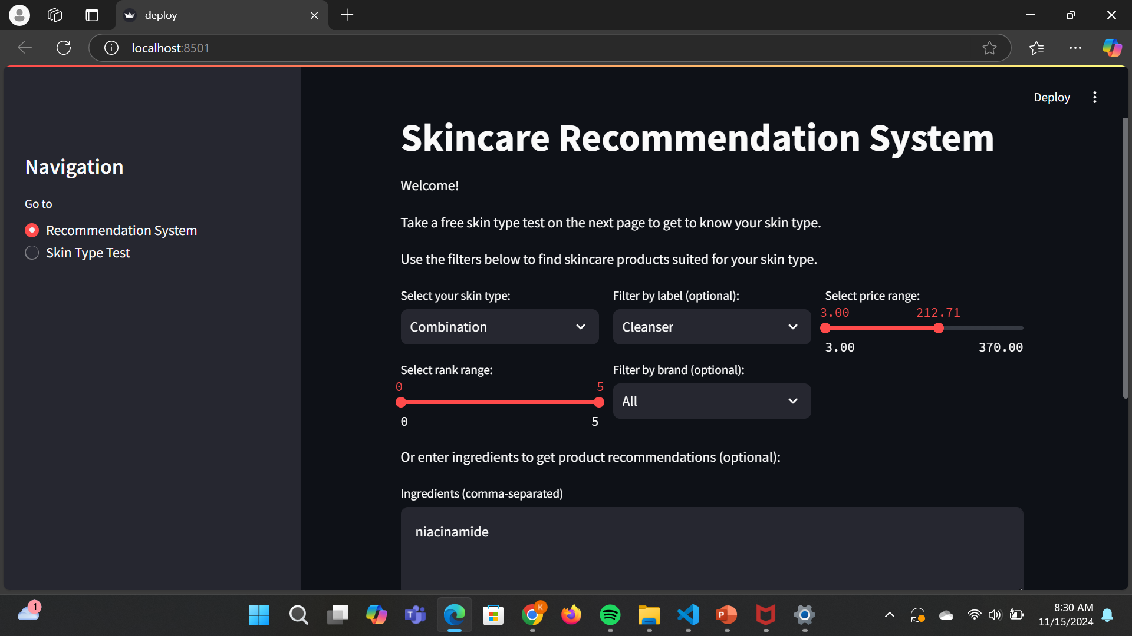
System deployment
The project was deployed on Streamlit, an open-source framework that allows building and learning of machine learning web applications.

Slide 13
Insights
Personalization Matters:
Users benefit from personalized skincare recommendations tailored to specific skin types and concerns.
Allowing ingredient-based filtering enables users to avoid allergens or target preferred active ingredients.
Importance of Ingredient Similarity:
Using cosine similarity on ingredient vectors highlights which products have similar compositions.
Data-Driven Decision Making:
Product rankings, labels, and user-defined filters add layers of refinement, showcasing the importance of multiple data points in the recommendation process.
The combination of NLP and user preferences enhances recommendation accuracy and relevance.
Usability of NLP in Product Recommendations:
Tokenization and TF-IDF vectorization effectively capture the unique attributes of skincare ingredients.
NLP techniques allow us to quantify and compare textual data, making it applicable to any product with ingredient lists.

Slide 14
Summary

Slide 15
Conclusion
Project Summary
Feedback
Successfully implemented and deployed a personalized recommendation system for skincare products.
Leveraged NLP techniques like TD-IDF and Cosine Similarity to analyze product ingredients.
Future Enhancements
Include user feedback to improve recommendations.
Expand to other product categories and additional user preferences
Project Summary

Slide 16
THANK YOU
Feel free to ask any questions!

